Slide 1

EMS – Enterprise Management System
AI-Powered Smart Billing for Local Stores
Department of Artificial Intelligence & Machine Learning Under the Guidance of: Mr. Sai Kumar (Lecturer)

Slide 2

Introduction: Meet EMS
What is EMS?
"If you can speak, you can bill."
EMS (Enterprise Management System) is an intelligent billing solution designed specifically for local stores and small businesses. It harnesses the power of artificial intelligence to transform traditional retail operations into modern, efficient systems.
Why Does It Exist?
Small businesses form the backbone of our economy, yet they often lack access to affordable, user-friendly technology. EMS bridges this gap by bringing enterprise-level capabilities to neighborhood stores.
Our tagline captures the essence of accessibility – breaking down barriers between shopkeepers and technology through the most natural interface: voice.

Slide 3

The Problem We're Solving
Time-Consuming Manual Billing
Calculation & Stock Errors
Human errors in pricing, inventory tracking, and totaling lead to financial losses and customer dissatisfaction. Manual stock registers often become outdated or inaccurate.
Traditional billing processes consume valuable time that could be spent serving customers. Handwritten bills, manual calculations, and register management create bottlenecks during peak hours.
Limited Accessibility
Semi-literate shopkeepers struggle with complex software interfaces. Language barriers and technical complexity prevent many from adopting digital solutions.

Slide 4

Our Motivation: Democratizing Technology
01
02
Bridge the Digital Divide
Empower Small Business
Make powerful AI tools accessible and affordable for every local store, regardless of the owner's technical expertise or literacy level.
Enable local retailers to compete with larger establishments by providing enterprise-grade analytics and automation at an accessible scale.
03
Close the Technology Gap
Transform how traditional stores operate by introducing voice-first interfaces that feel natural and eliminate learning curves.

Slide 5




Our Core Objectives
Automate Billing
Multilingual Voice
Replace manual processes with AI-driven automation that generates bills in seconds
Enable voice-based billing in Hindi, English, and Telugu for maximum accessibility
Smart Analytics
Universal Access
Provide actionable insights through intuitive dashboards and predictive reporting
Design for everyone, including users with limited literacy or technical skills

Slide 6






Key Features That Power EMS
Voice-Based Billing
Auto Bill Generation
Purchase Tracking
Speak naturally to generate bills—no typing required. Our AI understands context and intent.
Professional invoices created instantly with accurate calculations and formatting.
Monitor every transaction with detailed records and easy retrieval.
AI Chat-bot Assistant
Inventory Alerts
Sales Analytics
Get instant help with queries, troubleshooting, and system navigation.
Smart notifications for low stock, expiring items, and reorder suggestions.
Visualize performance metrics, identify trends, and make data-driven decisions.

Slide 7

System Architecture
EMS follows a modern four-layer architecture designed for scalability, maintainability, and optimal performance.
Frontend Layer
Responsive user interface built with HTML, CSS, and JavaScript. Provides intuitive navigation and real-time updates for seamless user experience.
Backend Layer
Node.js server handling business logic, API endpoints, and request processing. Manages authentication, validation, and data flow coordination.
Database Layer
MySQL database storing transactions, inventory, user data, and analytics. Ensures data integrity and supports complex queries for reporting.
AI Layer
Integration with ChatGPT, Gemini, and Perplexity for voice processing, natural language understanding, and intelligent assistance.

Slide 8










System Workflow
AI Processing
User Interaction
Voice recognition and NLP interpret the input
Shopkeeper speaks or types product details
Bill Generation
System creates formatted invoice with pricing
Analytics Display
Dashboard updates with latest sales metrics
Inventory Update
Stock levels automatically adjusted in real-time
This seamless cycle completes in under 30 seconds, transforming hours of manual work into moments of effortless automation.

Slide 9
Technology Stack
Development Technologies
AI & Design Tools
Front end
Design
HTML5, CSS3, JavaScript: Modern web standards ensuring responsive design and interactive user interfaces.
Figma: Collaborative interface design and prototyping for creating intuitive user experiences.
Back end
AI Integration
Node.js: Efficient server-side JavaScript runtime for handling concurrent requests and real-time operations.
ChatGPT, Gemini, Perplexity: Multiple AI models for voice recognition, NLP, and intelligent assistance.
Database
Development
MySQL: Reliable relational database for structured data storage with ACID compliance.
bolt.new, v0.dev: AI-assisted code generation tools accelerating development and ensuring best practices.

Slide 10





AI Integration: The Intelligence Behind EMS
ChatGPT Integration
Gemini Integration
Powers conversational interactions, interprets complex voice commands, and provides context-aware responses. Handles natural language queries and assists with system navigation.
Enhances multilingual understanding and improves accuracy across Hindi, Telugu, and English. Processes voice inputs with superior accent recognition and contextual comprehension.
Perplexity Integration
AI-Assisted Development
Supports research-driven features, product information retrieval, and intelligent suggestions. Assists in code optimization and problem-solving during development.
Leveraged bolt.new and v0.dev for rapid prototyping and component generation, significantly accelerating development cycles while maintaining code quality.

Slide 11
Results & Impact
92-95%
70%
3
100%
Voice Accuracy
Time Saved
Languages
Mobile Ready
Achieved through rigorous testing across accents and dialects
Billing time reduced from 3-5 minutes to under 1 minute
Supporting Hindi, English, and Telugu for true inclusivity
Fully responsive design works on any device
Key Achievements
AI-Powered Intelligence
Real-Time Operations
Pilot Success
Successfully integrated multiple AI models for voice recognition and business analytics
Implemented live inventory tracking with instant updates across all devices
Validated with real shopkeepers who reported increased efficiency and customer satisfaction

Slide 12






Team Excellence Behind EMS
A diverse team of talented individuals brought EMS to life, each contributing unique expertise and dedication.
Mohammed Sohail
Shanmukha Sai Prabhath
Keerthana
Tharuni
Team Leader / Developer
Developer
Report Author
Research Lead
Vijayashri
Shameena
QA Analyst
Report Contributor
Abdul Samad
Ramdas
UI/UX Developer
Resource Collector
We extend our heartfelt gratitude to Mr. Sai Kumar, our project guide, the faculty of the Department of Artificial Intelligence & Machine Learning, and our institution for their unwavering support and guidance throughout this journey. Thank you for believing in our vision.

Slide 13
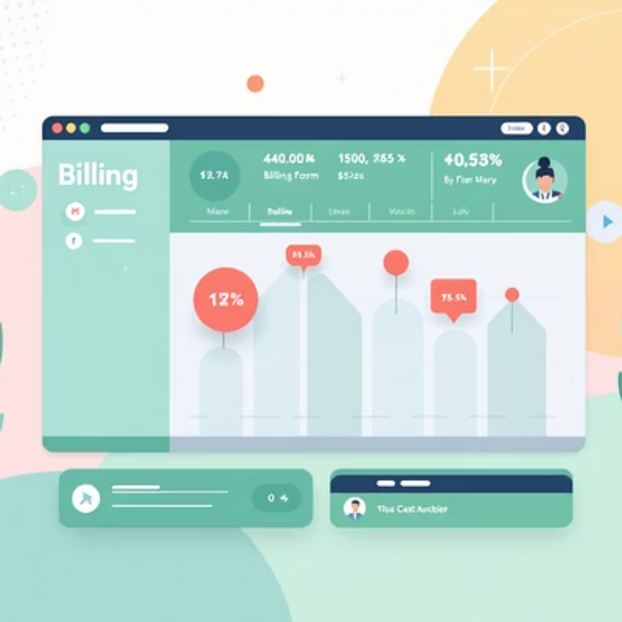

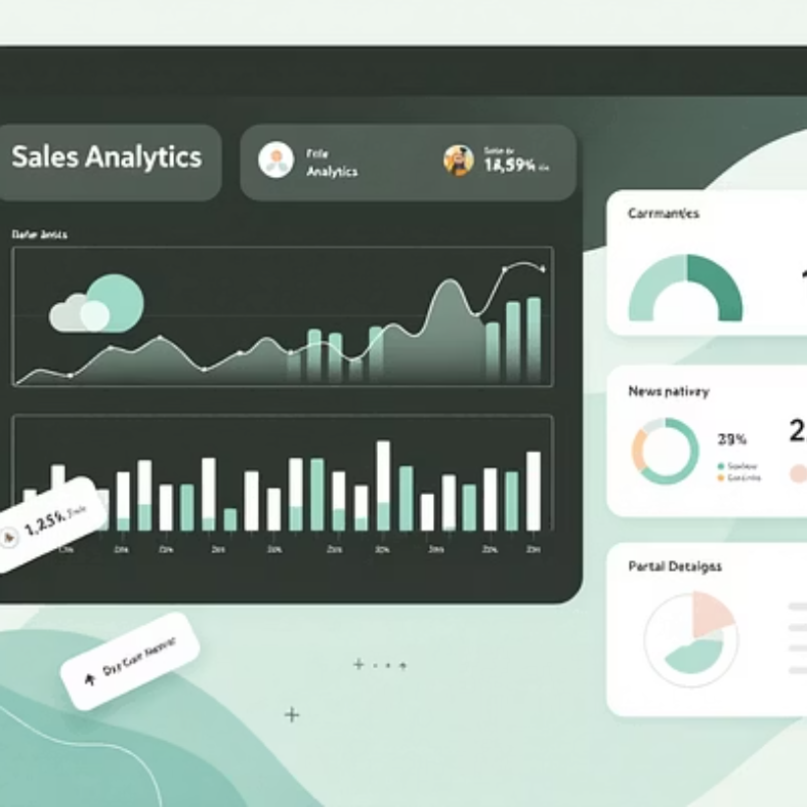
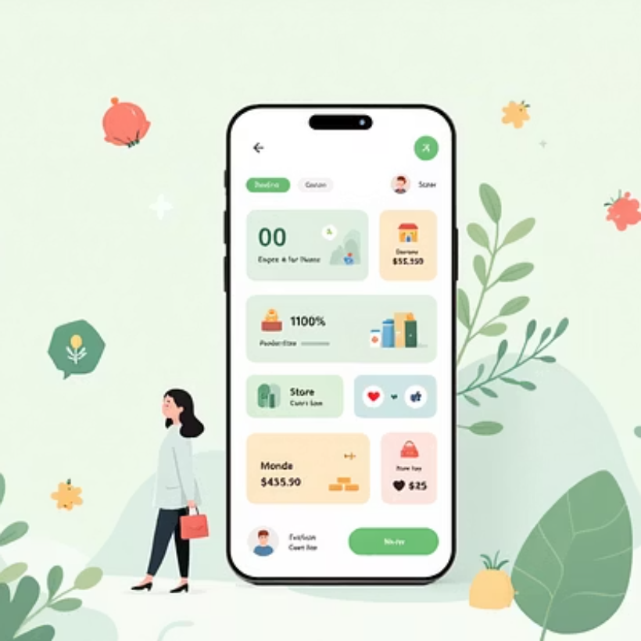
User Interface Showcase
Our interface balances simplicity with functionality—large touch targets, clear visual hierarchy, and minimal text ensure accessibility for all users. The design follows material design principles while maintaining cultural relevance for Indian retail contexts.

